Slide 1
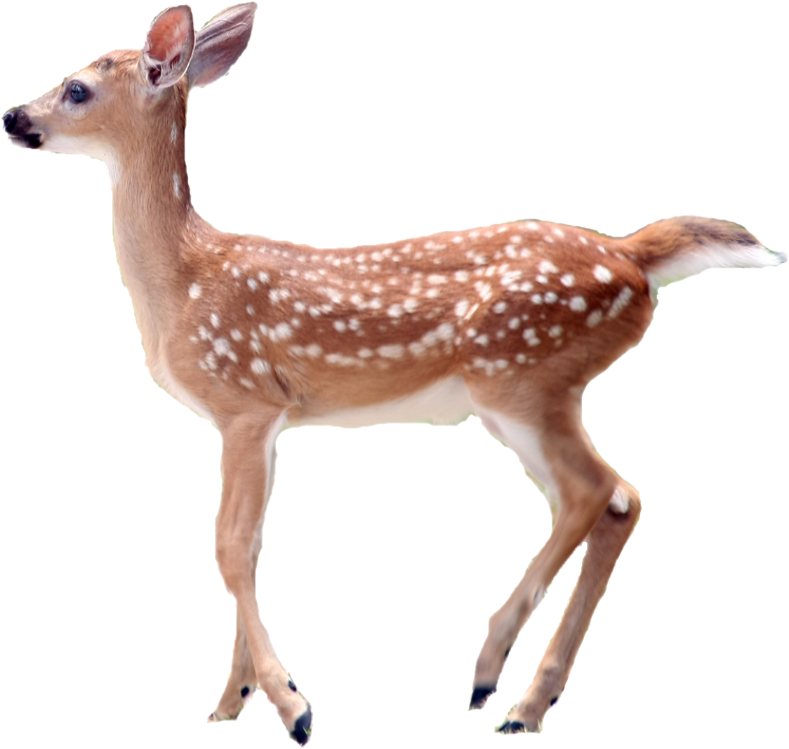
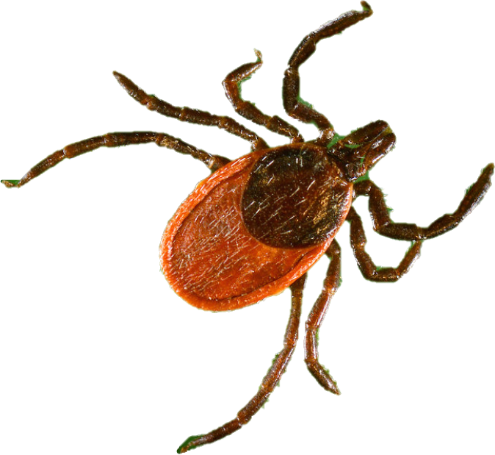
Don’t let a tick Make you sick!
July 2020
Notes:
Today we are going to learn about ticks so you can protect yourself from getting sick. Ticks are little bugs that can bite you and make you sick if you aren’t careful.

Slide 2
It’s important to learn how to protect yourself from ticks so you don’t get sick! Ticks can give you different diseases; the most common one in New Jersey is called Lyme disease. Watch this video carefully to learn about ticks: https://www.youtube.com/watch?v=jvUsFY_6AR8
Notes:
We’re going to watch a short video that will help you learn more. Pay attention because after the video we’re going to play a game where you have to answer questions from the video!

Slide 3
Question 1:
Tiny
Medium
BIG
How big
are ticks?
Notes:
How big are ticks? Are they tiny, like the size of a poppy seed? Medium, like the size of a penny? Or big, like the size of your palm?

Slide 4
Click here to learn more!
Not quite!
Ticks are tiny! They are about the size of a poppy seed and can often be mistaken for freckles.
Make sure to look closely and feel for bumps when performing a tick check.
Notes:
Not quite right! Ticks are tiny, about the size of a poppy seed. Because they’re so small they can easily be confused for freckles on your skin. Unlike freckles, ticks will be little bumps on the skin so pay attention when doing a tick check!

Slide 5
Click here to learn more!
Correct!
You’re right! Ticks are about the size of a poppy seed and can often be mistaken for freckles.
Make sure to look closely and feel for bumps when performing a tick check!
Notes:
Perfect! Ticks are tiny, about the size of a poppy seed. Because they’re so small they can easily be confused for freckles on your skin. Unlike freckles, ticks will be little bumps on the skin so pay attention when doing a tick check!

Slide 6
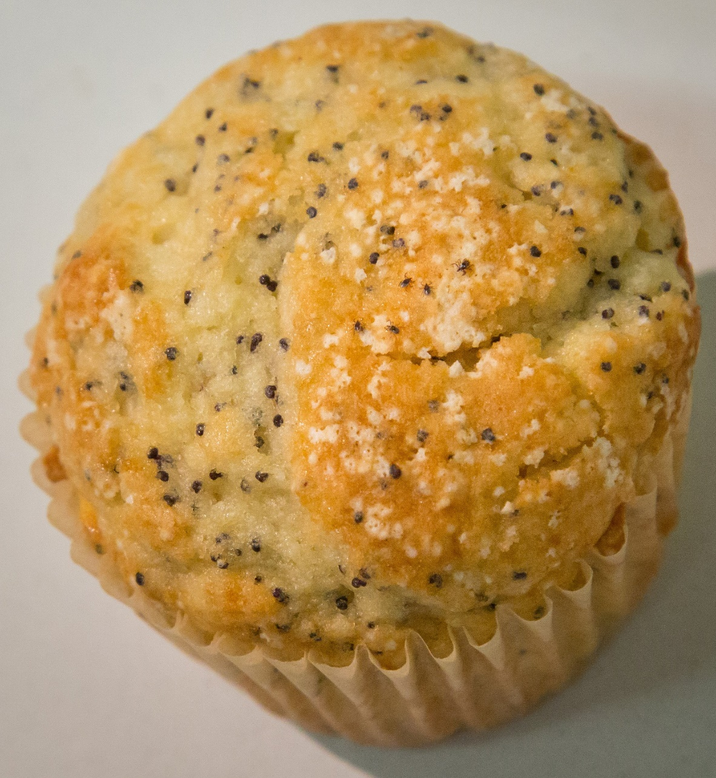
Can you spot all 5 ticks on this poppy seed muffin?
Notes:
Can you spot all 5 ticks on this poppy seed muffin?

Slide 7
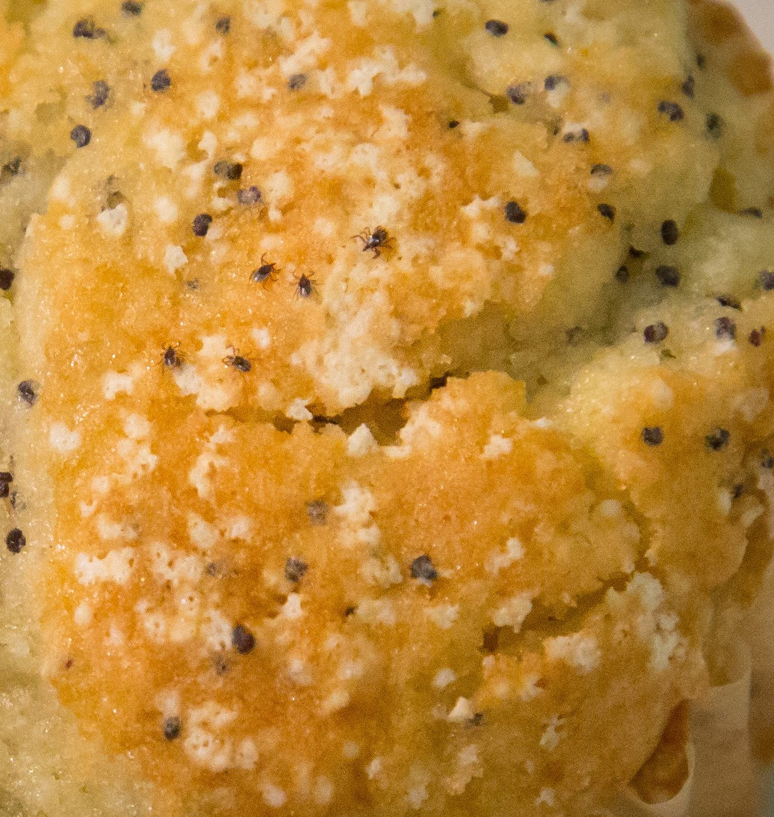
Notes:
Here’s a close-up look! Can you find the 5 ticks?

Slide 8
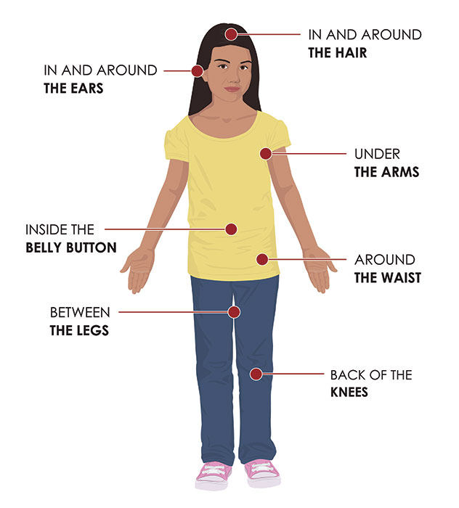
Tick Checks
Remember to do this after playing outside!
Ask a parent or trusted adult to help you perform a tick check and pay extra attention to places marked in the photo.
Image from cdc.gov
Notes:
We’re going to talk about how to do a tick check but you should ask your parent for help because ticks like to hide in places we can’t see on ourselves. You can see in the photo some of these places include behind the ears, under your arms, between your legs, and even inside your belly button! If you’ve been outside, pay extra attention when you do a tick check. You should check for ticks as soon as you come back inside. We’re going to give you a fun calendar where you can check off or put a sticker on each day that you do a tick check!

Slide 9
If you find a tick on yourself,
don’t touch it!
STOP
Instead…show a trusted adult such as a teacher or parent and they will help you remove the tick.
Notes:
When you do a tick check, look for ticks but don’t touch them! Touching them can make it easier for them to make you sick so you should always tell a parent or an adult that you found a tick. Who are some adults you could tell? (teacher, school nurse, older sibling, etc)

Slide 10
Question 2:
In trees
In long grass
In the ocean
Where do ticks live?
Notes:
Where do ticks live? Do they live in the trees, in long grass, or by the ocean?

Slide 11
Click here to learn more!
Not quite!
Ticks like long grass and dark, wet areas.
To avoid them, play in open areas with lots of sun!
Notes:
Nope! Ticks like to live in long grass and brush like in the woods. They also like when it’s dark, wet, and warm. Especially when it’s warm outside, you can avoid most ticks by playing in open areas with short grass and lots of sun! If you’re walking through the woods stay on the path and away from the bushes.

Slide 12
Click here to learn more!
Correct!
Ticks like long grass and dark, wet areas.
To avoid them, play in open areas with lots of sun!
Notes:
Right! Ticks like to live in long grass and brush like in the woods. They also like when it’s dark, wet, and warm. Especially when it’s warm outside, you can avoid most ticks by playing in open areas with short grass and lots of sun! If you’re walking through the woods, stay on the path and away from the bushes.

Slide 13
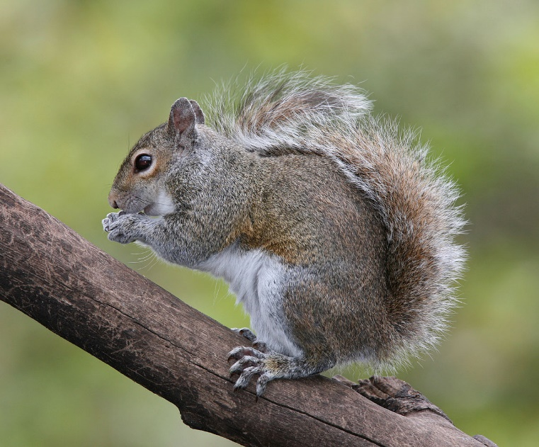
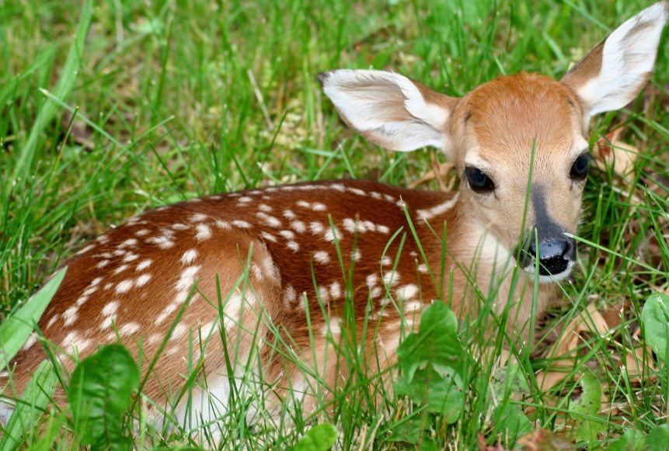
Ticks don’t only catch a ride on humans; they are also found on animals such as:
and dogs!
squirrels
deer
Notes:
Ticks bite all different kinds of animals and like to catch a ride of other animals so they can move around faster. This is especially important if you have a pet that goes outside because they can carry ticks into your house! When you do a tick check on yourself make sure to also check your pets, especially on top of their head and their legs. What are some animals you can think of that might carry ticks? (this is most animals that run around outside…squirrels, deer, dogs, mice, groundhogs, bunnies, etc)
Picture Sources:

Slide 14
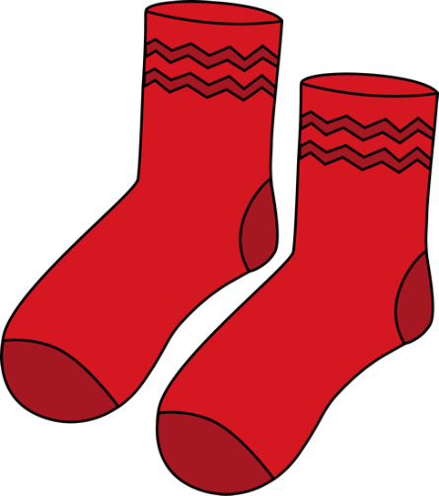
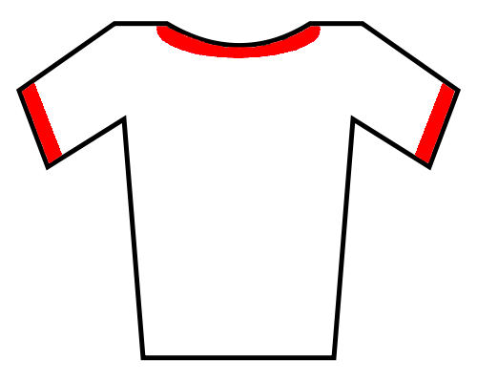
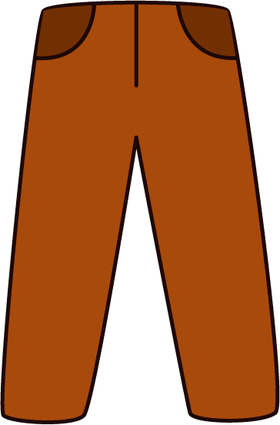
Question 3:
Which of these should you wear to protect against ticks?
t-shirt
long pants
socks
sunglasses
Notes:
Which of these pictures show something you should wear outside to protect yourself against ticks? We have socks, long pants, a short sleeve t-shirt, and sunglasses.

Slide 15
Question 3:
Which of these should you wear to protect against ticks?
t-shirt
long pants
socks
sunglasses
Notes:
Correct/almost there! Instead of wearing a short sleeve t-shirt, a light-colored long-sleeve shirt is better to protect against tick bites. And, although sunglasses help protect you from the sun, they don’t do much against ticks.

Slide 16
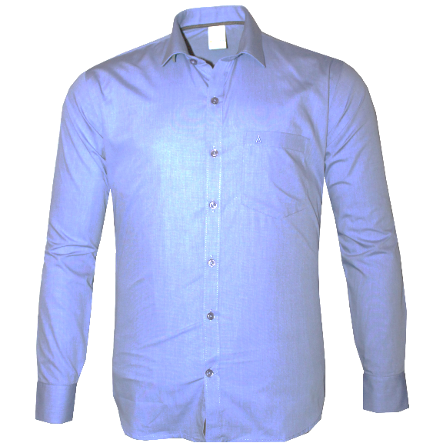
Make sure to tuck your pants into your socks!
Socks
Long Pants
Long Sleeves
Notes:
Like you saw on the last slide, you should try to cover as much of your body as possible with clothes. Wear long pants that you can tuck into long socks and a long sleeve top on top. If you wear something that’s light in color, it makes it easier to see ticks on you as well! When you come inside from playing, give your clothes to a parent to clean and take a shower right away. The longer a tick has the chance to crawl on you, the more likely it is to bite you!

Slide 17
Question 4:
Fill in the blank:
Before going outside to play, ask an adult to help you put on insect ________!
Notes:
Last question! This is a fill in the blank, ‘before going outside to play, ask an adult to help you put on insect ______’.

Slide 18
Question 4:
Fill in the blank:
Before going outside to play, ask an adult to help you put on insect repellent!
Notes:
The correct answer is repellent! Insect repellent is important to keep insects from wanting to go near you. Think of it like an invisibility spell, the bugs can’t smell you so it makes it harder for them to find you.

Slide 19
Remember!
Ticks are tiny so perform a tick check after being outside.
Wear long pants, long sleeves, socks, and insect repellent outside.
If you find a tick on yourself, show an adult right away!
Play in open, sunny areas.
Notes:
We learned a lot so let’s go over the most important things to remember. First, ticks are tiny so be very careful when you do a tick check, which you should do after being outside. If you do find a tick, do not touch it. Show a parent or another trusted adult right away. When you go outside, wear long pants tucked into socks and a long sleeve shirt. Ask your parent or trusted adult to help you put on insect repellent, your invisibility cloak! And, play in areas that are open and sunny with short grass.

Slide 20
Don’t let a
TICK
SICK!
make you
Notes:
Ticks can be dangerous but if you remember and use the lessons we learned today, you can protect yourself! Don’t let a tick make you sick!

Slide 21
Photo Sources
https://www.cdc.gov
https://www.goodfreephotos.com/vector-images/colorful-natural-tree-vector-clipart.png.php
https://newsd.co/man-tried-bid-goodbye-fawn-reacted-unbelievable-way-2/
https://www.pexels.com/photo/photography-of-tree-1067333/
https://www.pexels.com/photo/green-grass-41324/
https://www.carbonbrief.org/guest-post-what-does-the-paris-agreement-mean-for-oceans
Notes:
Photo Sources:
https://www.cdc.gov
https://www.goodfreephotos.com/vector-images/colorful-natural-tree-vector-clipart.png.php
https://newsd.co/man-tried-bid-goodbye-fawn-reacted-unbelievable-way-2/
https://www.pexels.com/photo/photography-of-tree-1067333/
https://www.pexels.com/photo/green-grass-41324/
https://www.carbonbrief.org/guest-post-what-does-the-paris-agreement-mean-for-oceans

